Slide 1


DEFENCE AND SPACE
Surrogate Factory
An MLOps platform for building, validating and deploying simulation surrogate models
ARNABAT MARTIN, MARTA
17 July 2026

Slide 2
Contents
01
The Challenge
02
The Surrogate Model Approach
Why high-fidelity simulation has become the bottleneck of aerospace engineering workflows.
How statistically validated machine-learning models deliver physics results in milliseconds.
03
The Platform — Surrogate Factory
04
Validation Framework
Architecture, nine-stage pipeline, configuration-driven design and open model catalog.
A four-layer statistical methodology and fully automated HTML validation reports.
05
Use Cases and Results
06
The Case for MLOps
UCFatigue and UCLoads: real structural problems, measured accuracy, honest conclusions.
What an industrialised platform returns in reproducibility, speed, trust and scale.

Slide 3
01
The Challenge
Physics-based simulation delivers reference-quality answers — at a computational price that modern design loops can no longer afford.

Slide 4

High-Fidelity Simulation Is a Bottleneck
Finite-element and computational-fluid-dynamics solvers are the backbone of structural and aerodynamic engineering. They are also expensive: a single fatigue or loads computation can occupy a workstation for hours, and every design question — a new mass case, a revised flight point, an updated geometry — restarts the clock from zero.
The scale of the problem grows with the ambition of the analysis. Sweeping one aircraft loads envelope already means hundreds of thousands of flight conditions; optimisation studies, trade-off analyses and what-if sessions multiply that figure. In practice, engineers do not run the analyses they need — they run the analyses they can afford to wait for.
Hours → ms
357,000+
× 10⁶
per evaluation once a validated surrogate replaces the physics solver in the loop
flight conditions in a single aircraft loads envelope (UCLoads production dataset)
typical speed-up factor between a CFD/FEM run and surrogate model inference

Slide 5







What Is a Surrogate Model?
Physics solver
Training dataset
ML training & validation
Deployed surrogate
FEM / CFD reference computations
DoE campaigns and historical runs
Statistical learning with quality gates
Millisecond predictions in the loop
A surrogate model is a machine-learning approximation of an expensive simulation, trained on solver results and validated statistically over the flight envelope where it is intended to operate. Once qualified, it answers in milliseconds the same question the solver answers in hours — with quantified accuracy, quantified uncertainty and a documented domain of validity. The physics solver remains the reference; the surrogate absorbs the volume.
Optimisation loops
Real-time what-if
Fleet-scale screening
thousands of evaluations inside MDO and sizing iterations
interactive envelope exploration during design reviews
load and fatigue checks across entire mission catalogues

Slide 6


From Hand-Crafted Scripts to an Industrial Process
Ad-hoc surrogate scripts
Surrogate Factory — engineered MLOps
Irreproducible — results depend on whoever ran the notebook, and on which day
Reproducible — every model is rebuilt exactly from a versioned YAML configuration
Untraceable — no record of data, parameters or code behind a delivered model
Traceable — every run logs parameters, metrics, data and source scripts to MLflow
Unverified — validation is manual, partial and different for every project
Validated — a standard four-layer statistical gate precedes every model release
Unportable — models live and die on one engineer's laptop
Portable — artifacts export to ONNX and store on local disk, S3 or GCS
Unrepeatable — every new use case starts again from a blank page
Reusable — one pipeline template serves every programme and discipline
The difference between a promising prototype and an engineering asset is not the algorithm — it is the process around it. Machine-learning operations (MLOps) provide that process: versioned configuration, tracked experiments, systematic validation and deployable artifacts, applied uniformly to every surrogate the organisation builds.

Slide 7
02
The Platform — Surrogate Factory
An Airbus Inner Source MLOps framework, version 2.2, that standardises the full surrogate lifecycle from requirements to deployment.

Slide 8





Surrogate Factory v2.2 at a Glance
Surrogate Factory is a Python framework, distributed under the Airbus Inner Source shared-maintenance model, that turns surrogate development into a standardised, auditable pipeline. Each stage is a Jupyter notebook driven by declarative YAML metadata; a shared Workflow object carries configuration, logging, data access and experiment tracking across the whole chain, and can be orchestrated visually with the Elyra pipeline editor, from a standalone script, or notebook by notebook.
Configuration-driven
Modular catalog
Tracking built in
Portable by design
The complete pipeline — data locations, models, tracker, methods — is declared in schema-validated YAML. The configuration is the single source of truth.
Estimators, checks, tuners and converters are registered by name and resolved at run time, so new methods plug in without touching the framework.
A pluggable tracker interface ships with an MLflow implementation: parameters, learning curves, per-output metrics and EDA artifacts are logged for every run.
fsspec-based storage scaffolds and runs pipelines on local disk, S3 or GCS; trained models export to ONNX for tool-independent deployment.
One command to start. The package installs with pip and ships a CLI — surrogate-factory — that scaffolds a complete, ready-to-run pipeline skeleton with all nine stages, templates and metadata, locally or directly on cloud object storage.

Slide 9

One Standardised Pipeline — Nine Stages
SF_1 Requirements
SF_2 Data Acquisition
SF_3 Data Cleansing
SF_4 Data Partitioning
SF_5 Feature Selection
SF_6 Model Selection
SF_7 Model Training
SF_8 Model Deployment
SF_9 Model Validation
Every surrogate follows the same nine numbered stages, from the capture of engineering requirements to the statistical validation of the delivered model. Each stage is one notebook plus one YAML metadata file; the shared Workflow object threads configuration, data and logging between them, so the pipeline can be executed visually in the Elyra editor, headlessly with a standalone runner script, or interactively stage by stage — always producing the same artifacts.
Because every project uses the same skeleton, an engineer who has seen one Surrogate Factory pipeline can read, review and rerun any other — a property no collection of personal scripts can offer.
+ SF_10 · Storage
An optional tenth stage registers the frozen model and its evidence package in the model store, closing the loop from experiment to governed, versioned asset.

Slide 10
Declarative by Design — the Pipeline Is a Configuration File
pipeline_config.yaml · UCLoads use case (verbatim, paths abbreviated)
A single YAML file defines the entire job: where data lives, where artifacts go, which experiment tracker records the run, and which model classes the catalog exposes. Nothing about the pipeline is hidden inside code.
Stage-level metadata is validated against a JSON schema before execution, and the resulting metadata store travels with the job — any colleague, auditor or future self can rerun the configuration and obtain the same model.
The catalog maps plain names to importable classes, so adding a new estimator to a programme is a one-line change, and switching the tracking backend or moving the whole pipeline to object storage never touches the engineering code.
Surrogate Factory: '2.2'
job_name: UCLOADS_1
data.folder: .../pipeline/data
artifacts.folder: .../data/artifacts
metadata.folder: .../pipeline/metadata
input_data: .../datasets/TrainData
tracker:
tool: mlflow
options:
tracking_uri: sqlite:///.../mlruns.db
catalog:
models:
MLPRegressor: sklearn.neural_network.MLPRegressor
RandomForest: model_training.estimators.RandomForest
MultiOutputXGBoost: model_training.estimators.MultiOutputXGBoost
PyTorchNN: model_training.estimators.PyTorchNN

Slide 11
Two Snippets Tell the Whole Story
SF_6_Model_Selection.yaml · WHAT to train
model_training/learn.py · HOW it runs
Model_Selection:
inputs: [Mach, Altitude_ft, ALPHA_deg]
outputs: [Fz_WINGROOT, Mx_WINGROOT, ...,
Mz_FUS]
algorithms:
- name: MultiOutputGradientBoosting
label: GradientBoosting
settings:
n_estimators: 100
max_depth: 4
learning_rate: 0.1
subsample: 0.8
min_samples_leaf: 5
random_state: 42
@sf.node
def train(workflow, Train_set, Val_set):
"""Train every algorithm declared
in Model_Selection."""
ms = workflow.metadata.get_step_data(
['metadata', 'Model_Selection'])
for alg in ms['algorithms']:
cls = workflow.catalog.get_method(alg['name'])
model = cls(**alg['settings'])
model.fit(X_scaled, Train_Y)
joblib.dump(model, artifacts /
f"model_{job}_{alg['label']}.modl")
Engineers declare what should happen in YAML; decorated node functions define how, once, for everyone. The @sf.node decorator supplies logging, error wrapping, metadata recording and artifact management transparently — every training function automatically documents which script produced which model, with which settings, on which data. Fixed random seeds throughout make each result exactly repeatable.

Slide 12



An Open Model Catalog
The catalog ships with five production-ready multi-output regression families, all exposed behind the same scikit-learn interface — and any estimator that honours that interface can be registered alongside them.
MLP
Gradient Boosting
Random Forest
XGBoost
PyTorch Residual NN
scikit-learn feed-forward network with ReLU activations, Adam optimiser and early stopping.
Boosted trees per output via MultiOutputRegressor — the strongest baseline on tabular data.
Natively multi-output ensemble; robust, low-tuning reference for any new dataset.
Regularised gradient boosting wrapped per output for high-accuracy tabular regression.
Custom deep residual network (LayerNorm, GELU, skip connections) with internal output standardisation.
Hyper-parameter tuning as configuration. Optuna search spaces are declared per output directly in the SF_6 YAML — layer-size choices, log-scaled regularisation ranges, static parameters — so systematic tuning campaigns are versioned, reviewable and repeatable like everything else in the pipeline. When Optuna is not installed, the pipeline degrades gracefully to the declared static settings.

Slide 13
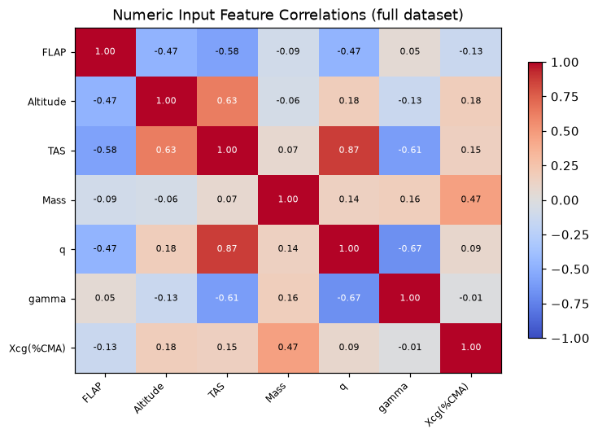


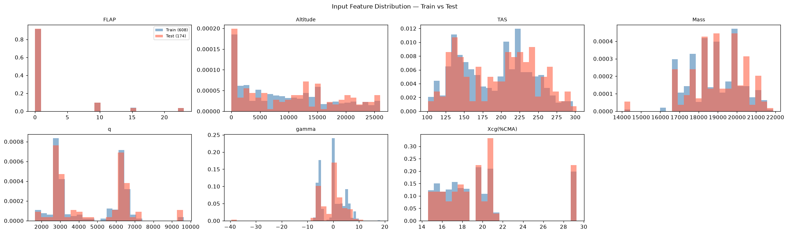

MLOps Capabilities Out of the Box
Experiment tracking
Every training run logs hyper-parameters, learning curves and per-output R², MAE, Q90 and KS statistics to MLflow.
Metadata & lineage
A schema-validated metadata store records every stage's inputs, outputs and source script — full provenance for every model.
Registry & versioned artifacts
Models are persisted as job-keyed artifacts (scaler + estimator pipelines) with a dedicated storage stage for governed reuse.
Automated EDA
Correlation matrices, input/output distributions and PCA design-space coverage are generated and logged for every run.
Interoperable deployment
ONNX export (skl2onnx / tf2onnx) plus fsspec storage make models consumable far beyond the Python ecosystem.
EDA artifacts logged automatically to MLflow for every UCFatigue run: input–output correlation matrix and input feature distributions.

Slide 14
03
Validation Framework
A surrogate is only as useful as the evidence behind it. Surrogate Factory makes statistical validation systematic, automatic and non-negotiable.

Slide 15
A Four-Layer Validation Methodology
Validation is powered by validationlib, a dedicated statistical library developed jointly by Airbus and Universidad Politécnica de Madrid within the ISAMI+ collaboration. Every candidate model must pass four successive layers of evidence before it can be frozen.
1
Split quality
Voxel Tesselation Proximity and χ² tests verify that train, validation and test sets partition the design space fairly — before any model is trained.
2
Distribution coverage
Kolmogorov–Smirnov and Anderson–Darling tests plus convex-hull analysis confirm the model is evaluated inside the domain it actually learned.
3
Precision & residuals
Per-output R², MAE and Q90 against explicit requirements; bias detection through Pearson/Spearman trends and Kruskal–Wallis tests on binned residuals.
4
Engineering evidence
Scatter and ratio plots, residual distribution fits, and binned uncertainty and coverage models delivering 95 % confidence intervals per output.
A model is released only after all four layers pass — and when it fails, the layers say why.

Slide 16
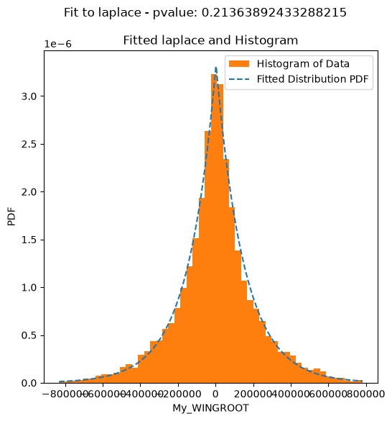
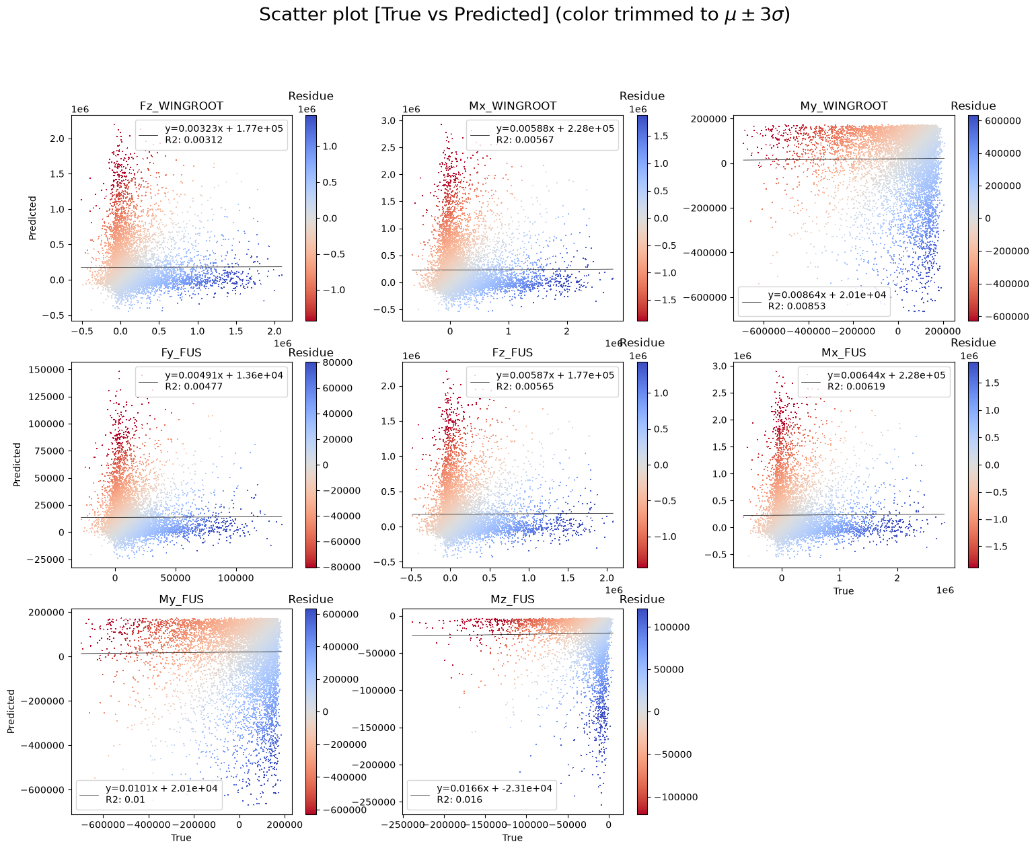
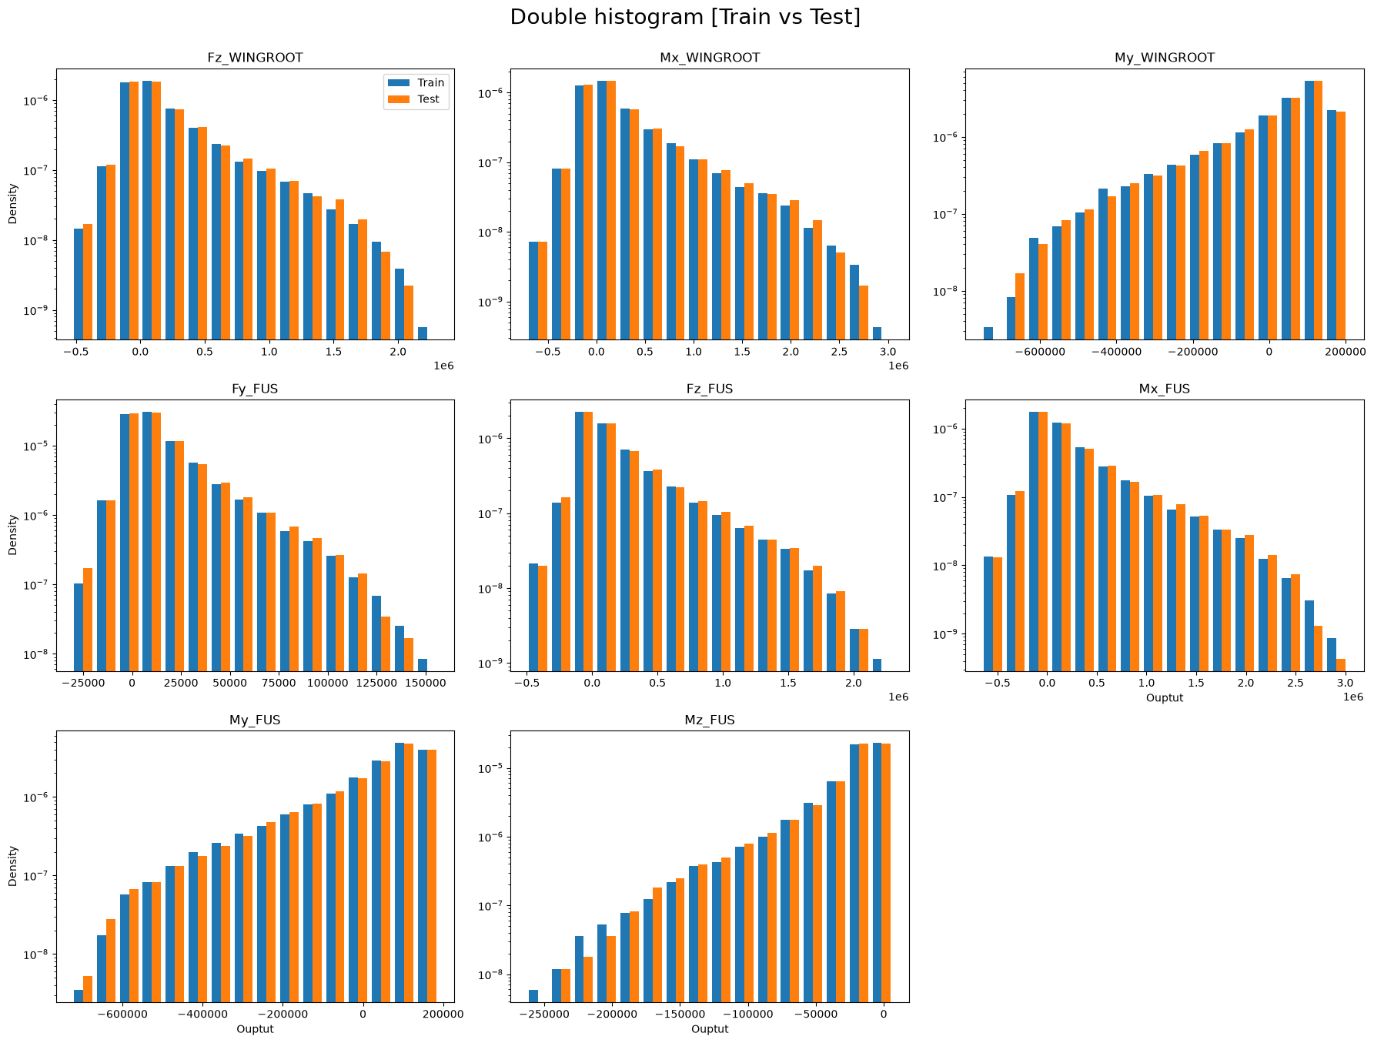
Every Model Ships With an Automated Validation Report
One command executes a parameterised validation notebook against each trained model and renders it into a self-contained HTML report — more than sixty statistical checks and plots, from exploratory data analysis to bias tables and uncertainty coverage, with every figure embedded. The report opens in any browser, needs no Python environment, and gives stress engineers, reviewers and certification stakeholders the complete evidence package behind a single link. The figures below are taken directly from the UCLoads GradientBoosting report.
Residual distribution fit with goodness-of-fit p-value (layer 4)
True vs predicted per output, coloured by residual (layer 3)
Train vs test distribution overlap per output (layer 2)

Slide 17
04
Use Cases and Results
Two real structural disciplines — fatigue and aerodynamic loads — built, tracked and validated end-to-end on the platform.

Slide 18
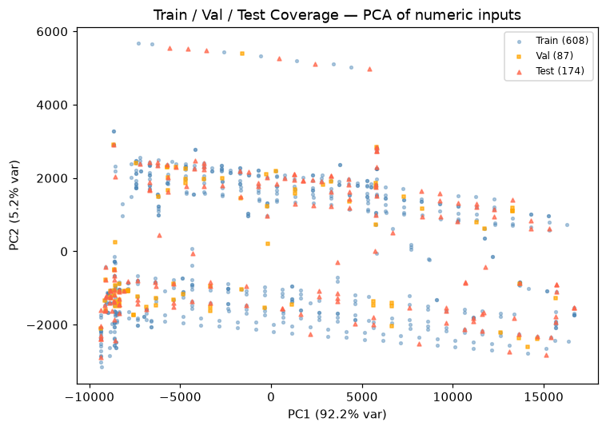
Use Case 1 · UCFatigue — Structural Fatigue Loads
UCFatigue replaces hours-long finite-element fatigue computations for structural element SSE 2110017 with a surrogate that answers in milliseconds. Eight flight and segment parameters — flap setting, altitude, true airspeed, mass, dynamic pressure, flight-path angle, segment type and centre-of-gravity position — predict seven fatigue load components, from the 1g reference case to vertical gust and turn loads.
The development subset holds roughly 870 points, partitioned 70/10/20 into train, validation and test sets with a fixed seed. After one-hot encoding and standardisation the model sees nineteen features. The acceptance requirement is explicit and demanding: for each output, ninety per cent of predictions must fall within ten per cent of the reference value (Q90 < 0.10).
PCA design-space coverage of train / validation / test — split quality verified before training (validation layer 1).
8 → 7
≈ 870
Q90 < 10 %
input parameters to fatigue load outputs (19 features after encoding)
development points, split 70 / 10 / 20 with fixed random seed
acceptance requirement on relative error, per output

Slide 19
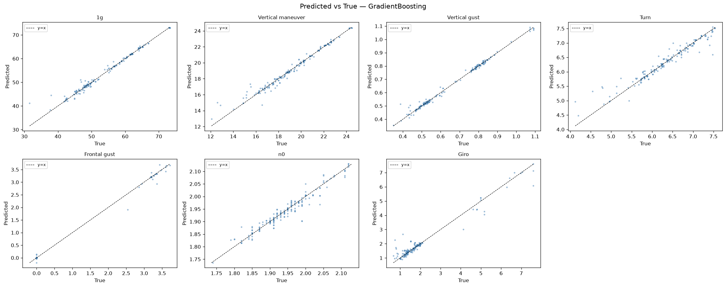
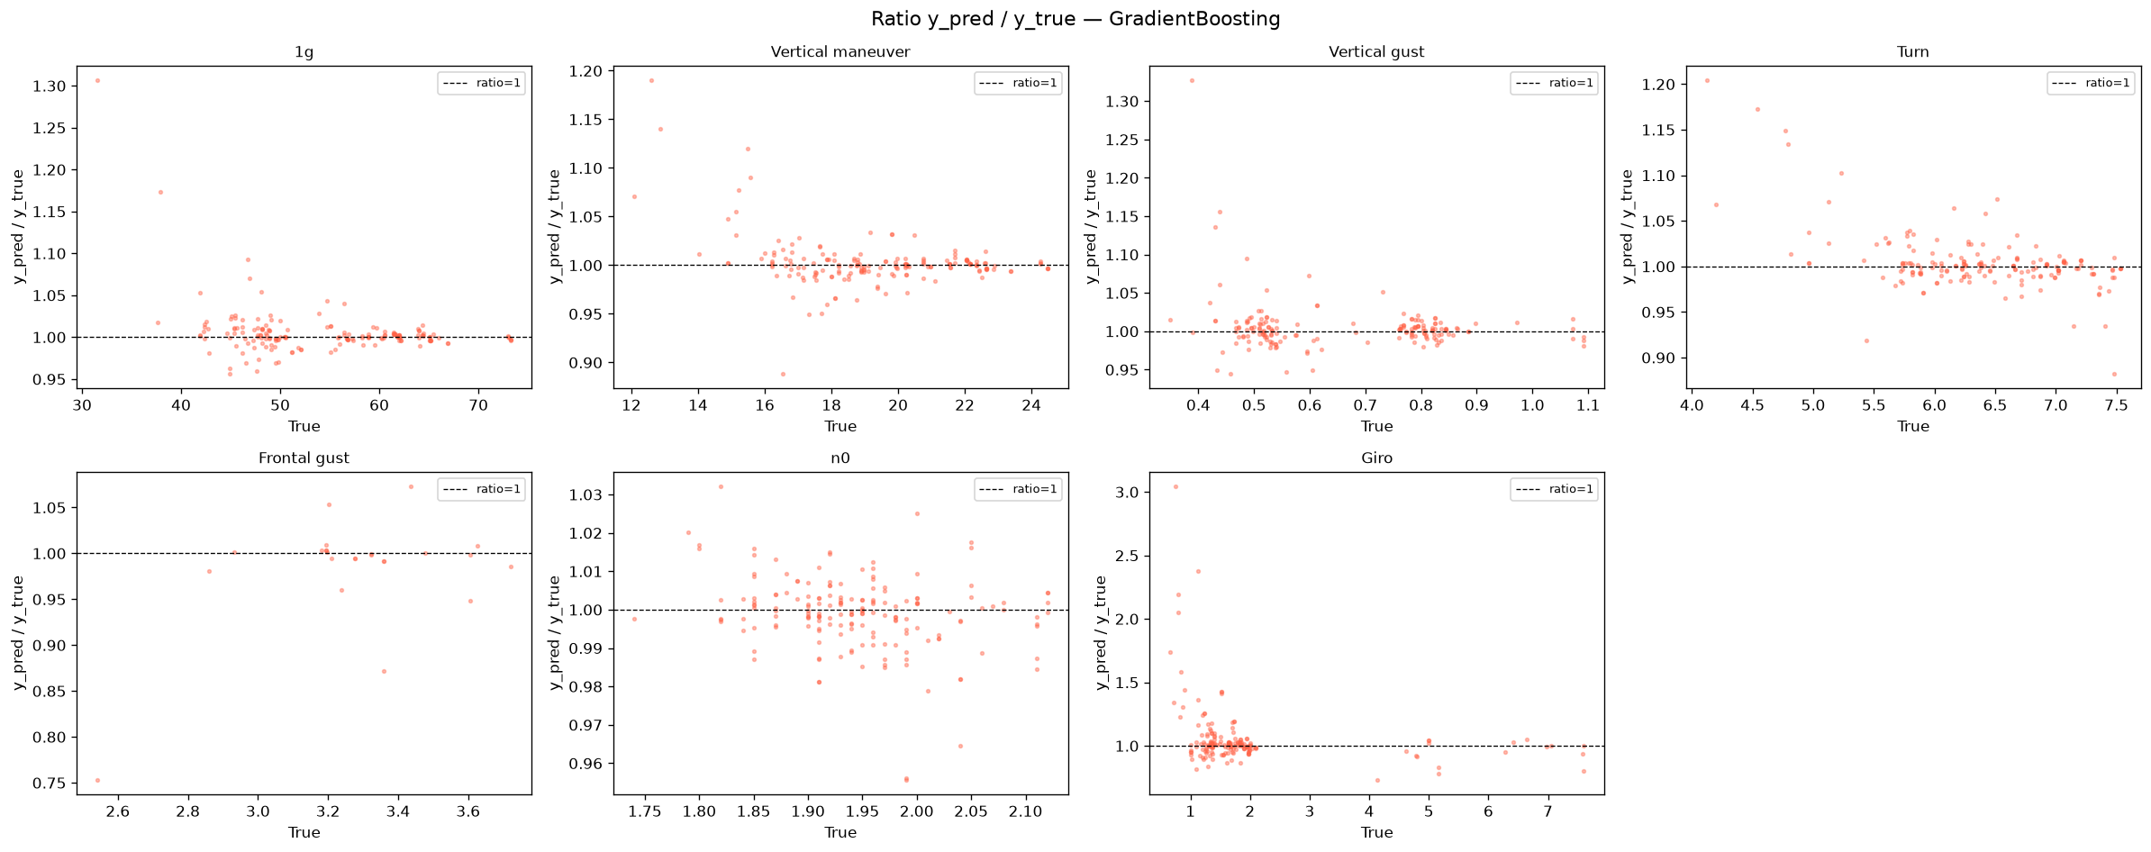
UCFatigue — Results on the Development Subset
Output | GB R² | GB Q90 | Requirement | MLP R²
1g | 0.980 | 0.026 | Pass | 0.916
Vertical manoeuvre | 0.972 | 0.032 | Pass | 0.912
Vertical gust | 0.991 | 0.026 | Pass | 0.938
Turn | 0.929 | 0.035 | Pass | 0.754
Frontal gust | 0.996 | 0.280 | Fail | 0.979
n0 | 0.932 | 0.015 | Pass | −0.729
Giro | 0.950 | 0.222 | Fail | −0.104
Gradient Boosting outperforms the MLP on every one of the seven outputs, and five of them already meet the Q90 < 10 % requirement on a subset of only ~870 points — with Q90 as low as 1.5 % for the n0 case. The MLP, by contrast, collapses to negative R² on two outputs, confirming that small tabular datasets favour tree ensembles over neural networks.
The two failing outputs, Frontal gust and Giro, fail in both architectures — a signature the validation framework reads as a data-coverage problem rather than a modelling one.
GradientBoosting · predicted vs true (test set)
GradientBoosting · prediction ratio (test set)

Slide 20
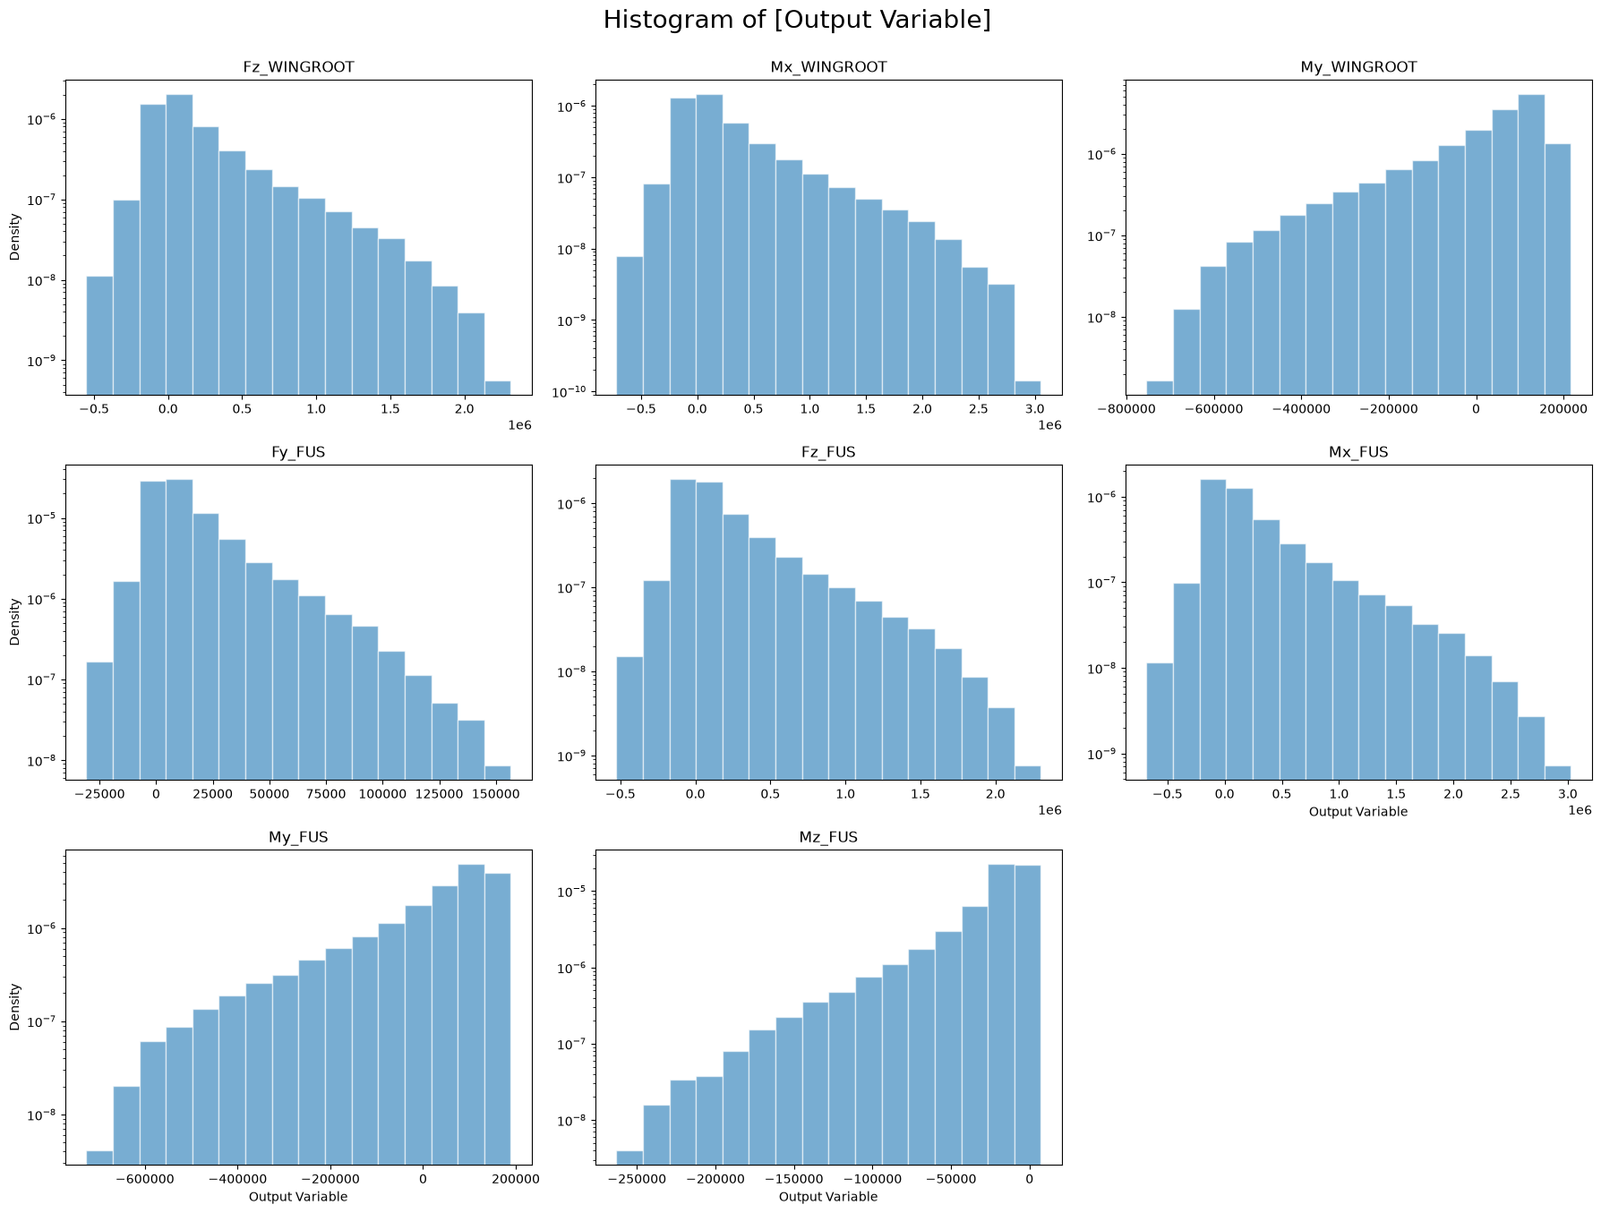
Use Case 2 · UCLoads — Aerodynamic Structural Loads
UCLoads targets the loads process directly: predicting eight force and moment components at the wing-root and fuselage monitor stations from just three flight parameters — Mach number, altitude and angle of attack. The production dataset covers 357,000 CFD-derived flight conditions spanning Mach 0.4 to 1.4, altitudes up to 50,000 ft and incidences from −7.5° to 32.5°.
Development to date uses a 2,000-point synthetic dataset calibrated to the real statistics, on which five model families — MLP, Gradient Boosting, Random Forest, XGBoost and the custom PyTorch residual network — are benchmarked head-to-head through the identical pipeline, with every run tracked in MLflow.
Distributions of the eight load outputs at the two monitor stations, from the automated validation report.
3 → 8
5 families
357 k
flight parameters to load components at two monitor stations
of models benchmarked through one identical pipeline
real CFD flight conditions in the production dataset

Slide 21
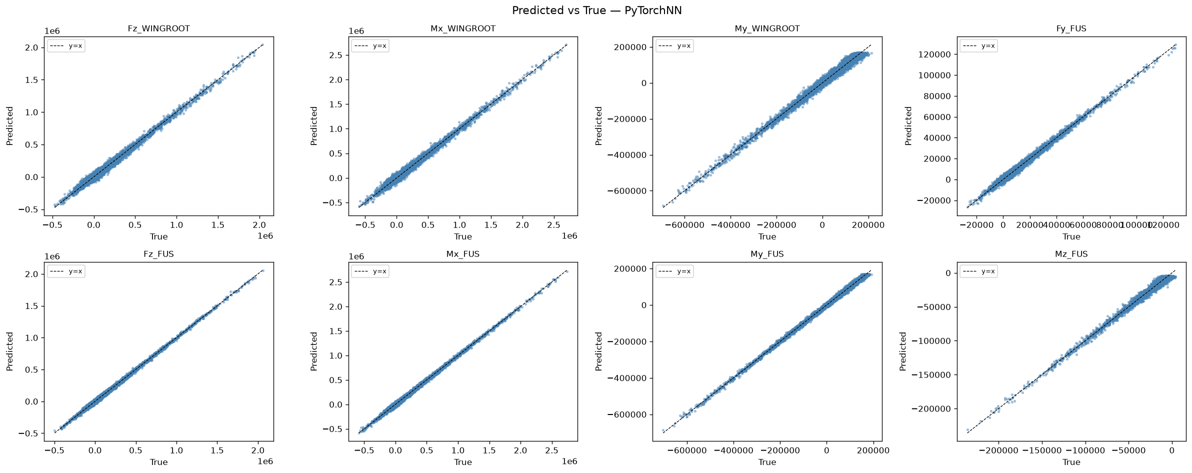
UCLoads — Five Models, One Verdict
The custom PyTorch residual network posts the best R² on seven of the eight outputs — up to 0.998 — while the Kolmogorov–Smirnov overfitting test clears it on all eight outputs, the only model besides the MLP with a perfect score. Gradient Boosting remains an excellent, cheaper baseline.
On synthetic data the Q90 targets are bounded by the injected 10 % noise floor, as expected; the recommendation is a scaled PyTorch network plus a Gradient Boosting baseline on the full 357 k-point CFD dataset.
PyTorch residual network: predicted vs true on the held-out test set, all eight outputs.

Slide 22


When Validation Speaks, Engineering Listens
In UCFatigue, two outputs — Frontal gust and Giro — missed the Q90 requirement. The reflex answer would have been to reach for a bigger network, a longer tuning campaign, a different architecture. The four-layer evidence said otherwise: both outputs failed in both model families while the split quality, coverage tests and remaining five outputs were healthy. That pattern isolates the root cause as insufficient data coverage in specific regions of the envelope — a problem no amount of hyper-parameter tuning can fix.
The engineering action changed accordingly: enrich the dataset where the evidence points, instead of burning weeks of compute and effort on blind retraining. This is precisely what a validation framework is for — turning model failures into directed, defensible engineering decisions.
Detect
Layer-3 precision tests flag Frontal gust and Giro above the Q90 threshold in every architecture.
Diagnose
Cross-model failure with healthy splits and coverage points to the data, not the algorithms.
Act
Targeted data enrichment is scheduled; retraining effort is redirected, not wasted.
The avoided cost: months of speculative retraining and compute, replaced by one evidence-based data acquisition decision.

Slide 23


Why Invest in an MLOps Platform
Reproducibility
Speed
Any delivered model can be rebuilt exactly from its versioned configuration and tracked run — the audit trail that certification-minded engineering demands, produced as a by-product of normal work rather than as an afterthought.
The nine-stage skeleton, reusable node library and one-command scaffolding compress surrogate development from a bespoke, weeks-long effort into days — and every stage built for one programme is immediately available to the next.
Trust
Scale
A mandatory four-layer statistical gate and automatically generated evidence reports mean that when a surrogate ships, its accuracy, bias and domain of validity are documented — and when it fails, the failure is diagnosed, not debated.
One platform serves every discipline: fatigue today, aerodynamic loads tomorrow, any simulation-backed domain after that. Cloud-ready storage, MLflow tracking and ONNX export turn individual models into an organisational asset base.
The question is not whether surrogate models will enter the engineering process — they already have. The question is whether they arrive as untracked scripts or as governed, validated, reusable assets.

Slide 24




Roadmap and Next Steps
1
2
3
4
Production datasets
Engineering hardening
Registry rollout
New use cases
Train UCLoads on the full 357 k-point CFD dataset; scale the PyTorch network (256 units, 6 residual blocks) and confirm Q90 compliance on deterministic data.
Extend automated unit tests and continuous integration across the framework and node libraries, with pipeline-level regression runs on reference datasets.
Deploy the SF_10 storage stage and the MLflow model registry as the governed distribution channel for validated surrogates across teams.
Onboard further FEM- and CFD-backed disciplines onto the platform, reusing the pipeline skeleton, catalog and validation gate as they stand.
The platform is running, the methodology is proven and two use cases have carried real structural problems from raw data to validated surrogates. The next increment is deliberately unglamorous — production data, tests, governance — because that is what separates a successful pilot from engineering infrastructure. Every element of this roadmap builds on components that already exist in Surrogate Factory v2.2 today.

Slide 25

Thank you
Surrogate Factory — from expensive simulation to validated, millisecond engineering answers.
ARNABAT MARTIN, MARTA · DEFENCE AND SPACE · 17 July 2026

